Slide 1
UBER TRIPS ANALYTICS | SQL EDITION
UBER TRIPS
ANALYTICS
SQL • OPERATIONS • REVENUE • DEMAND
TAXI
From raw trip records to clear business decisions
NYC GREEN TAXI TRIP ANALYSIS
SQL • Demand • Revenue • Geography
SQL ANALYSIS • 10 QUESTIONS • 2017–2020
SQL-only presentation
Power BI deck will be delivered separately
Prepared by: [Bhoopendra Singh ]
SQL DECK • 01

Slide 2
How to read this deck
EVERY QUESTION INCLUDES THE QUESTION, SUBMITTED SQL SCREENSHOT, RESULT SCREENSHOT, AND INTERPRETATION.
01–05
Trips, revenue, peak times, borough share, frequent routes
06–10
Passenger load, trip distance, payment type, tips, borough-pair revenue
Evidence
Uploaded SQL screenshots are included as supplied; result tables are interpreted in plain language
Quality
Potential query/data issues are called out rather than hidden
Note: SQL screenshots are placed as images for faithful visibility; the text can be edited by replacing the screenshot.
UBER TRIPS ANALYTICS • SQL CAPSTONE
02

Slide 3
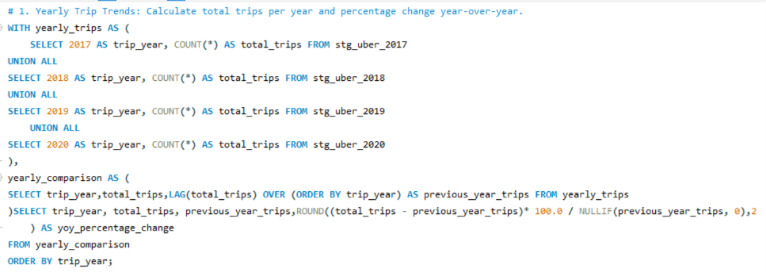
Question 01 | Yearly Trip Trends
CALCULATE TOTAL TRIPS PER YEAR AND YEAR-OVER-YEAR (YOY) PERCENTAGE CHANGE.
BUSINESS QUESTION 01 • SQL QUERY
03
UBER TRIPS ANALYTICS • SQL CAPSTONE
03
UBER TRIPS ANALYTICS • SQL CAPSTONE

Slide 4
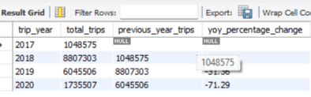
Question 01 | Result & interpretation
YEARLY TRIP TRENDS • OUTPUT PROVIDED IN YOUR SCREENSHOTS
KEY TAKEAWAY
2018 has the highest trip count in the supplied output (8,807,303). Trips then decline by 31.36% in 2019 and 71.29% in 2020. The sharp jump from 2017 to 2018 should be validated against source-table coverage.
Use this result with the Power BI dashboard for drill-down analysis.
04
UBER TRIPS ANALYTICS • SQL CAPSTONE
04
UBER TRIPS ANALYTICS • SQL CAPSTONE

Slide 5
INSIGHT 01 | Yearly Trip Trends
RESULT EXPLAINED • VISUAL SUMMARY • BUSINESS IMPLICATION
WHAT THE RESULT TELLS US
2018 records the highest trip count in this result set.
2019 is down about 31.4% from 2018; 2020 is down about 71.3% from 2019.
Validate year coverage and completeness before interpreting the drop as a real demand change.
The supplied output peaks in 2018, then falls sharply in 2019 and 2020.
Decision cue: use this insight alongside date, borough and route filters in the Power BI dashboard.
UBER TRIPS ANALYTICS • SQL EDITION
03

Slide 6
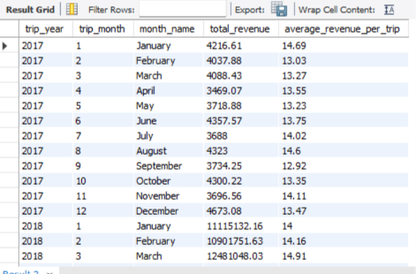
Question 02 | Monthly Revenue Insights
CALCULATE MONTHLY TOTAL REVENUE AND AVERAGE REVENUE PER TRIP.
BUSINESS QUESTION 02 • SQL QUERY
05
UBER TRIPS ANALYTICS • SQL CAPSTONE
05
UBER TRIPS ANALYTICS • SQL CAPSTONE

Slide 7
Question 02 | Result & interpretation
MONTHLY REVENUE INSIGHTS • OUTPUT PROVIDED IN YOUR SCREENSHOTS
KEY TAKEAWAY
The displayed 2017 monthly totals range from about 3,469 to 4,673, with December highest among the shown months. The 2018 values are in the millions, so verify units, filters and table coverage before comparing years.
Use this result with the Power BI dashboard for drill-down analysis.
06
UBER TRIPS ANALYTICS • SQL CAPSTONE
06
UBER TRIPS ANALYTICS • SQL CAPSTONE

Slide 8
INSIGHT 02 | Monthly Revenue Insights
RESULT EXPLAINED • VISUAL SUMMARY • BUSINESS IMPLICATION
WHAT THE RESULT TELLS US
Visible 2017 monthly revenue is roughly 3.47K–4.67K in the screenshot.
December is highest among the displayed 2017 months.
2018 values shown are much larger; confirm units, filters, and source-table consistency.
December 2017 is the highest of the visible 2017 months; cross-year totals need validation.
Decision cue: use this insight alongside date, borough and route filters in the Power BI dashboard.
UBER TRIPS ANALYTICS • SQL EDITION
04

Slide 9
Question 03 | Peak Day & Time Analysis
IDENTIFY THE DAY OF WEEK AND HOUR WITH THE HIGHEST AVERAGE TRIP VOLUME.
BUSINESS QUESTION 03 • SQL QUERY
SQL logic (reconstructed from the supplied result screenshot)
WITH all_trips AS (
SELECT lpep_pickup_datetime AS pickup_date FROM stg_uber_2017
UNION ALL SELECT lpep_pickup_datetime FROM stg_uber_2018
UNION ALL SELECT lpep_pickup_datetime FROM stg_uber_2019
UNION ALL SELECT lpep_pickup_datetime FROM stg_uber_2020
), daily_hourly_trips AS (
SELECT DATE(pickup_date) AS trip_date,
DAYOFWEEK(pickup_date) AS day_num,
HOUR(pickup_date) AS trip_hour, COUNT(*) AS total_trips
FROM all_trips WHERE pickup_date IS NOT NULL
GROUP BY DATE(pickup_date), DAYOFWEEK(pickup_date), HOUR(pickup_date)
), average_trips AS (
SELECT day_num, trip_hour, ROUND(AVG(total_trips),2) AS avg_trips
FROM daily_hourly_trips GROUP BY day_num, trip_hour
)
SELECT day_num, trip_hour, avg_trips FROM average_trips
ORDER BY avg_trips DESC LIMIT 10;
.
07
UBER TRIPS ANALYTICS • SQL CAPSTONE
07
UBER TRIPS ANALYTICS • SQL CAPSTONE

Slide 10
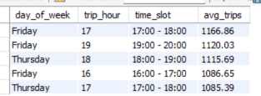
Question 03 | Result & interpretation
PEAK DAY & TIME ANALYSIS • OUTPUT PROVIDED IN YOUR SCREENSHOTS
KEY TAKEAWAY
Friday 17:00–18:00 is the top listed slot, averaging 1,166.86 trips. Friday late afternoon and early evening recur in the top five rows, suggesting a useful window to test targeted driver availability.
Use this result with the Power BI dashboard for drill-down analysis.
08
UBER TRIPS ANALYTICS • SQL CAPSTONE
08
UBER TRIPS ANALYTICS • SQL CAPSTONE

Slide 11
INSIGHT 03 | Peak Day & Time Analysis
RESULT EXPLAINED • VISUAL SUMMARY • BUSINESS IMPLICATION
WHAT THE RESULT TELLS US
Friday 17:00–18:00 leads at 1,166.86 average trips.
Late afternoon and early evening appear repeatedly in the top five.
Consider testing driver availability around these periods, then validate with seasonal and weekday controls.
Friday 5–6 PM has the highest average hourly volume in the displayed top rows.
Decision cue: use this insight alongside date, borough and route filters in the Power BI dashboard.
UBER TRIPS ANALYTICS • SQL EDITION
05

Slide 12
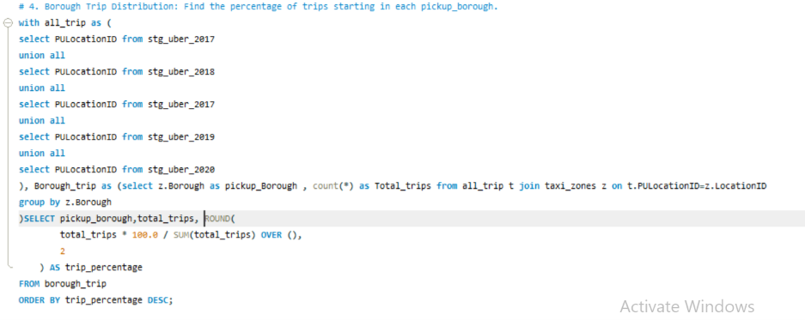
Question 04 | Borough Trip Distribution
CALCULATE THE PERCENTAGE OF TRIPS STARTING IN EACH PICKUP BOROUGH.
BUSINESS QUESTION 04 • SQL QUERY
09
UBER TRIPS ANALYTICS • SQL CAPSTONE
09
UBER TRIPS ANALYTICS • SQL CAPSTONE

Slide 13
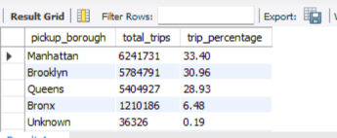
Question 04 | Result & interpretation
BOROUGH TRIP DISTRIBUTION • OUTPUT PROVIDED IN YOUR SCREENSHOTS
KEY TAKEAWAY
The result lists Manhattan at 33.40%, Brooklyn at 30.96%, Queens at 28.93%, the Bronx at 6.48%, and Unknown at 0.19%. The query screenshot appears to repeat the 2017 table and omit 2018 in its UNION list; correct this before final reporting.
Use this result with the Power BI dashboard for drill-down analysis.
10
UBER TRIPS ANALYTICS • SQL CAPSTONE
10
UBER TRIPS ANALYTICS • SQL CAPSTONE

Slide 14
INSIGHT 04 | Borough Trip Distribution
RESULT EXPLAINED • VISUAL SUMMARY • BUSINESS IMPLICATION
WHAT THE RESULT TELLS US
Manhattan has the largest pickup share at 33.40%.
Brooklyn and Queens follow closely at 30.96% and 28.93%.
Together, these three boroughs represent about 93.3% of trips in the supplied result.
Manhattan, Brooklyn and Queens account for the vast majority of pickup trips.
Decision cue: use this insight alongside date, borough and route filters in the Power BI dashboard.
UBER TRIPS ANALYTICS • SQL EDITION
06

Slide 15
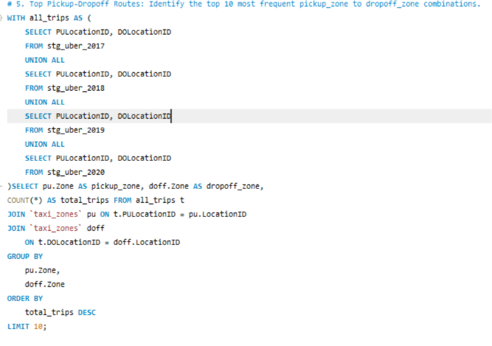
Question 05 | Top Pickup–Drop-off Routes
FIND THE 10 MOST FREQUENT PICKUP-ZONE TO DROP-OFF-ZONE COMBINATIONS.
BUSINESS QUESTION 05 • SQL QUERY
11
UBER TRIPS ANALYTICS • SQL CAPSTONE
11
UBER TRIPS ANALYTICS • SQL CAPSTONE

Slide 16
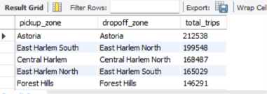
Question 05 | Result & interpretation
TOP PICKUP–DROP-OFF ROUTES • OUTPUT PROVIDED IN YOUR SCREENSHOTS
KEY TAKEAWAY
Astoria → Astoria is the most frequent displayed route with 212,538 trips. Other high-volume pairs include East Harlem South → East Harlem North (199,548) and Central Harlem → Central Harlem North (168,487). The supplied result screenshot visibly shows five rows; add the remaining rows if available.
Use this result with the Power BI dashboard for drill-down analysis.
12
UBER TRIPS ANALYTICS • SQL CAPSTONE
12
UBER TRIPS ANALYTICS • SQL CAPSTONE

Slide 17
INSIGHT 05 | Top Pickup–Drop-off Routes
RESULT EXPLAINED • VISUAL SUMMARY • BUSINESS IMPLICATION
WHAT THE RESULT TELLS US
Astoria → Astoria leads with 212,538 trips.
East Harlem South → East Harlem North is second at 199,548.
Use zone-level drill-down to support local fleet positioning; screenshot shows five rows although query requests ten.
Short intra-neighborhood routes dominate the visible top route combinations.
Decision cue: use this insight alongside date, borough and route filters in the Power BI dashboard.
UBER TRIPS ANALYTICS • SQL EDITION
07

Slide 18
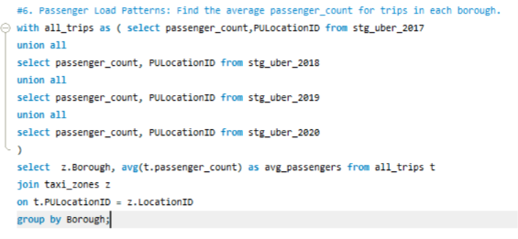
Question 06 | Passenger Load Patterns
CALCULATE AVERAGE PASSENGER COUNT FOR TRIPS BY PICKUP BOROUGH.
BUSINESS QUESTION 06 • SQL QUERY
13
UBER TRIPS ANALYTICS • SQL CAPSTONE
13
UBER TRIPS ANALYTICS • SQL CAPSTONE

Slide 19
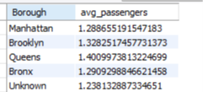
Question 06 | Result & interpretation
PASSENGER LOAD PATTERNS • OUTPUT PROVIDED IN YOUR SCREENSHOTS
KEY TAKEAWAY
The displayed averages are approximately 1.29 passengers in Manhattan, 1.33 in Brooklyn, 1.40 in Queens, 1.29 in the Bronx, and 1.24 for Unknown. These borough averages are relatively close, with Queens highest in the shown output.
Use this result with the Power BI dashboard for drill-down analysis.
14
UBER TRIPS ANALYTICS • SQL CAPSTONE
14
UBER TRIPS ANALYTICS • SQL CAPSTONE

Slide 20
INSIGHT 06 | Passenger Load Patterns
RESULT EXPLAINED • VISUAL SUMMARY • BUSINESS IMPLICATION
WHAT THE RESULT TELLS US
Queens averages about 1.40 passengers per trip.
Brooklyn is around 1.33; Manhattan and the Bronx are close to 1.29.
These are averages, not vehicle-capacity measures; inspect passenger-count nulls and outliers.
Average passenger counts are similar across boroughs; Queens is highest in the displayed output.
Decision cue: use this insight alongside date, borough and route filters in the Power BI dashboard.
UBER TRIPS ANALYTICS • SQL EDITION
08

Slide 21
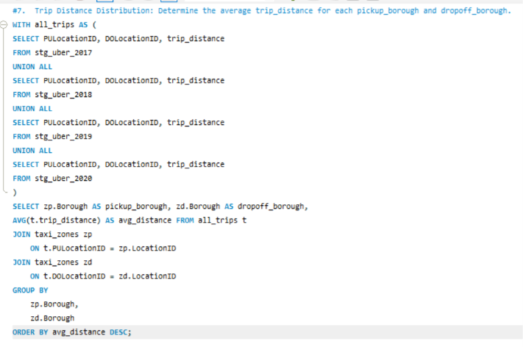
Question 07 | Trip Distance Distribution
CALCULATE AVERAGE TRIP DISTANCE FOR EACH PICKUP-BOROUGH AND DROP-OFF-BOROUGH PAIR.
BUSINESS QUESTION 07 • SQL QUERY
15
UBER TRIPS ANALYTICS • SQL CAPSTONE
15
UBER TRIPS ANALYTICS • SQL CAPSTONE

Slide 22
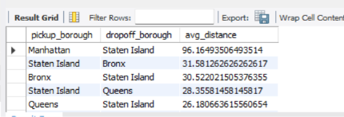
Question 07 | Result & interpretation
TRIP DISTANCE DISTRIBUTION • OUTPUT PROVIDED IN YOUR SCREENSHOTS
KEY TAKEAWAY
The longest average-distance pair shown is Manhattan → Staten Island at about 96.16 distance units. Staten Island → Bronx and Bronx → Staten Island are around 31.58 and 30.52. Confirm the dataset's distance unit and investigate low-frequency borough pairs.
Use this result with the Power BI dashboard for drill-down analysis.
16
UBER TRIPS ANALYTICS • SQL CAPSTONE
16
UBER TRIPS ANALYTICS • SQL CAPSTONE

Slide 23
INSIGHT 07 | Trip Distance by Borough Pair
RESULT EXPLAINED • VISUAL SUMMARY • BUSINESS IMPLICATION
WHAT THE RESULT TELLS US
Manhattan → Staten Island averages about 96.16 distance units.
Other leading pairs in the screenshot are around 26–32 units.
Confirm the distance unit and check low-volume pairs before using these values for planning.
Manhattan → Staten Island is the longest average-distance pair shown.
Decision cue: use this insight alongside date, borough and route filters in the Power BI dashboard.
UBER TRIPS ANALYTICS • SQL EDITION
09

Slide 24
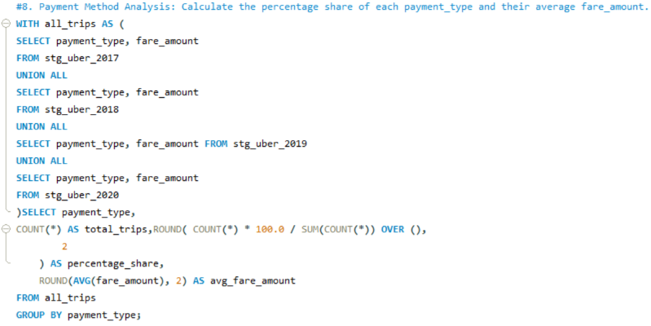
Question 08 | Payment Method Analysis
CALCULATE EACH PAYMENT TYPE'S SHARE OF TRIPS AND ITS AVERAGE FARE AMOUNT.
BUSINESS QUESTION 08 • SQL QUERY
17
UBER TRIPS ANALYTICS • SQL CAPSTONE
17
UBER TRIPS ANALYTICS • SQL CAPSTONE

Slide 25
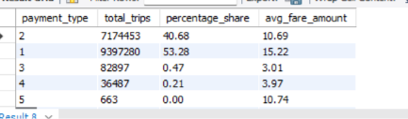
Question 08 | Result & interpretation
PAYMENT METHOD ANALYSIS • OUTPUT PROVIDED IN YOUR SCREENSHOTS
KEY TAKEAWAY
Payment type 1 accounts for 53.28% of trips with an average fare of 15.22; type 2 accounts for 40.68% with an average fare of 10.69. Types 3 and 4 are below 1% each. Decode numeric payment types into labels for a stakeholder-ready dashboard.
Use this result with the Power BI dashboard for drill-down analysis.
18
UBER TRIPS ANALYTICS • SQL CAPSTONE
18
UBER TRIPS ANALYTICS • SQL CAPSTONE

Slide 26
INSIGHT 08 | Payment Method Analysis
RESULT EXPLAINED • VISUAL SUMMARY • BUSINESS IMPLICATION
WHAT THE RESULT TELLS US
Type 1 leads with 53.28% share and average fare 15.22.
Type 2 contributes 40.68% with average fare 10.69.
Translate numeric payment codes into readable labels before presenting to business stakeholders.
Payment types 1 and 2 account for almost all trips in the output.
Decision cue: use this insight alongside date, borough and route filters in the Power BI dashboard.
UBER TRIPS ANALYTICS • SQL EDITION
10

Slide 27
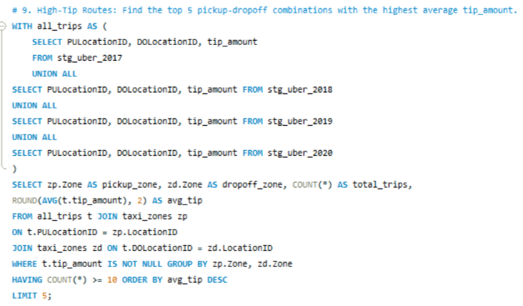
Question 09 | High-Tip Routes
FIND THE FIVE PICKUP–DROP-OFF COMBINATIONS WITH THE HIGHEST AVERAGE TIP AMOUNT.
BUSINESS QUESTION 09 • SQL QUERY
19
UBER TRIPS ANALYTICS • SQL CAPSTONE
19
UBER TRIPS ANALYTICS • SQL CAPSTONE

Slide 28
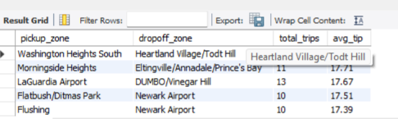
Question 09 | Result & interpretation
HIGH-TIP ROUTES • OUTPUT PROVIDED IN YOUR SCREENSHOTS
KEY TAKEAWAY
The top displayed route is Washington Heights South → Heartland Village/Todt Hill, but the screenshot's result row appears visually truncated or misaligned. Other listed routes show average tips around 17.39–17.71. Validate zone mapping and small sample sizes before interpreting rankings.
Use this result with the Power BI dashboard for drill-down analysis.
20
UBER TRIPS ANALYTICS • SQL CAPSTONE
20
UBER TRIPS ANALYTICS • SQL CAPSTONE

Slide 29
INSIGHT 09 | High-Tip Routes
RESULT EXPLAINED • VISUAL SUMMARY • BUSINESS IMPLICATION
WHAT THE RESULT TELLS US
The visible result lists average tips around 17.39–17.71 for four readable rows.
Some listed routes have only 10–13 trips, so a few transactions can shift the average substantially.
Validate the first row's alignment and use a minimum sample-size threshold before drawing conclusions.
The displayed top routes have high average tips but several have very small sample sizes.
Decision cue: use this insight alongside date, borough and route filters in the Power BI dashboard.
UBER TRIPS ANALYTICS • SQL EDITION
11

Slide 30
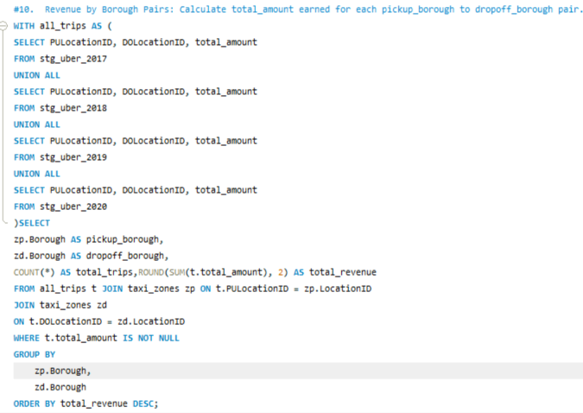
Question 10 | Revenue by Borough Pairs
CALCULATE TOTAL REVENUE FOR EACH PICKUP-BOROUGH TO DROP-OFF-BOROUGH PAIR.
BUSINESS QUESTION 10 • SQL QUERY
21
UBER TRIPS ANALYTICS • SQL CAPSTONE
21
UBER TRIPS ANALYTICS • SQL CAPSTONE

Slide 31
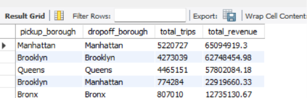
Question 10 | Result & interpretation
REVENUE BY BOROUGH PAIRS • OUTPUT PROVIDED IN YOUR SCREENSHOTS
KEY TAKEAWAY
Manhattan → Manhattan has the highest displayed revenue (about 65.09M), followed by Brooklyn → Brooklyn (about 62.75M) and Queens → Queens (about 57.80M). Same-borough pairs dominate the visible top rows; check currency, null handling and data coverage.
Use this result with the Power BI dashboard for drill-down analysis.
22
UBER TRIPS ANALYTICS • SQL CAPSTONE
22
UBER TRIPS ANALYTICS • SQL CAPSTONE

Slide 32
INSIGHT 10 | Revenue by Borough Pairs
RESULT EXPLAINED • VISUAL SUMMARY • BUSINESS IMPLICATION
WHAT THE RESULT TELLS US
Manhattan → Manhattan leads at about 65.09M in total revenue.
Brooklyn → Brooklyn and Queens → Queens follow at about 62.75M and 57.80M.
Confirm currency/scale and date coverage before comparing revenue across years or borough pairs.
Same-borough trips dominate the top revenue rows in the supplied output.
Decision cue: use this insight alongside date, borough and route filters in the Power BI dashboard.
UBER TRIPS ANALYTICS • SQL EDITION
12

Slide 33
Executive summary & validation checklist
KEY FINDINGS FROM THE TEN SUPPLIED SQL RESULT SETS
Trip volume
2018 is the highest-count year in the supplied output; subsequent years fall sharply.
Time
Friday 5–6 PM is the busiest listed hour/day slot.
Geography
Manhattan, Brooklyn and Queens dominate pickup share; local borough pairs also lead displayed revenue.
Passengers & distance
Queens has the highest displayed average passenger count; Manhattan → Staten Island has the longest displayed average distance.
Payments & tips
Payment types 1 and 2 dominate the result; high-tip route ranking needs sample-size and mapping checks.
Before final publication: fix the borough UNION list, verify year coverage/revenue units, label payment types, and validate tip-route row alignment.
23
UBER TRIPS ANALYTICS • SQL CAPSTONE
23
UBER TRIPS ANALYTICS • SQL CAPSTONE

Slide 34
Next stage | Power BI & predictive analytics
THIS SQL DECK IS DESIGNED TO MERGE WITH THE MATCHING DASHBOARD PRESENTATION LATER.
1
Power BI
Add dashboard overview, time demand, geographic patterns, passenger/distance, payment/tips pages.
2
Demand forecasting
Add model features, train/test split, evaluation metrics, and forecast chart.
3
High-tip prediction
Add target definition, model selection, evaluation metrics, and practical caveats.
4
Final recommendation
Combine SQL and dashboard evidence into operational actions.
End of SQL analysis section • Power BI screenshots to follow
24
UBER TRIPS ANALYTICS • SQL CAPSTONE
24
UBER TRIPS ANALYTICS • SQL CAPSTONE

Slide 35
UBER TRIPS ANALYTICS
🚕
POWER BI
DASHBOARD STORY
NYC MOBILITY • REVENUE • DEMAND
From operational data to visual insights and decisions
POWER BI EDITION • 5 DASHBOARDS
SQL + POWER BI = A COMPLETE ANALYTICS STORY
NYC GREEN TAXI TRIPS | 2017–2020
Five interactive report pages explained

Slide 36
Uber
Presentation Roadmap
POWER BI EDITION
TRIPS
ANALYTICS
WHAT THIS POWER BI EDITION COVERS
01
Trip & Revenue Overview
Scale, revenue, fare levels and yearly movement
02
Time-Based Demand
Hourly peaks and weekday patterns
03
Geographic Patterns
Borough mix, zones and trip distance
04
Payment & Tips
Payment mix and borough-level tipping
🚕
Passenger & Distance
Passenger load and distance differences
05
NYC GREEN TAXI
DATA PROJECT
The supplied screenshots are preserved as dashboard evidence; the following slides interpret the visible metrics.

Slide 37
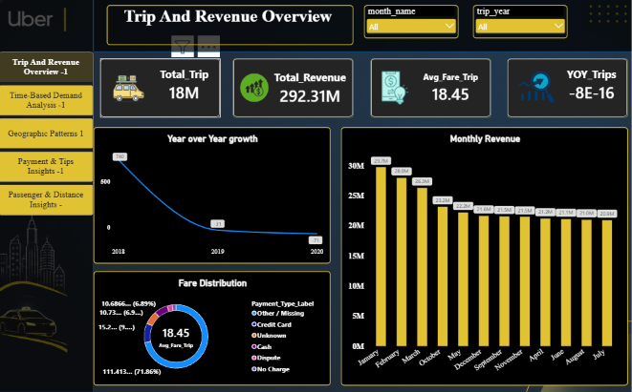
Uber
Dashboard 1: Trip & Revenue Overview
ORIGINAL POWER BI SCREENSHOT
TRIPS
ANALYTICS
FILTERS AND VISUALS AS PROVIDED
🚕
NYC GREEN TAXI
DATA PROJECT

Slide 38
Uber
Dashboard 1: Key Findings
INTERPRETATION • BUSINESS USE
TRIPS
ANALYTICS
KEY METRICS VISIBLE IN THE DASHBOARD
TOTAL TRIPS
TOTAL REVENUE
AVG FARE / TRIP
YOY TRIPS
18M
292.31M
18.45
-8E-16
WHAT THE DASHBOARD SHOWS
HOW THE BUSINESS CAN USE IT
The page summarizes the overall trip scale, total revenue and average fare.
Use monthly and yearly filters to isolate periods with material demand changes.
The monthly revenue chart is relatively high early in the visible period and trends lower later.
Compare revenue and trip counts together: revenue can change because of trip volume, fare mix or data coverage.
🚕
The yearly growth line falls sharply after 2018; validate year coverage and measure formatting before interpreting the KPI.
Fix the YoY KPI format; -8E-16 is effectively zero due to floating-point/measure formatting, not a meaningful business result.
NYC GREEN TAXI
DATA PROJECT
Interpretation is based on the values visible in the supplied screenshot; validate measures and filters in the PBIX before operational use.

Slide 39
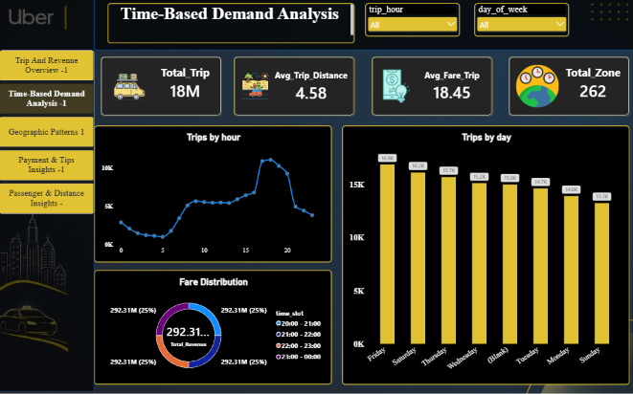
Uber
Dashboard 2: Time-Based Demand Analysis
ORIGINAL POWER BI SCREENSHOT
TRIPS
ANALYTICS
FILTERS AND VISUALS AS PROVIDED
🚕
NYC GREEN TAXI
DATA PROJECT

Slide 40
Uber
Dashboard 2: Key Findings
INTERPRETATION • BUSINESS USE
TRIPS
ANALYTICS
KEY METRICS VISIBLE IN THE DASHBOARD
TOTAL TRIPS
AVG TRIP DISTANCE
AVG FARE / TRIP
TOTAL ZONES
18M
4.58
18.45
262
WHAT THE DASHBOARD SHOWS
HOW THE BUSINESS CAN USE IT
The hourly line shows demand rising through the day, with the strongest activity around late afternoon / early evening.
Test driver positioning before the late-afternoon/evening peak, using more than one representative week.
The weekday bar chart ranks Friday highest among the displayed days, followed by Saturday and Thursday.
Compare weekdays with weekends and seasonality before changing shift plans.
🚕
The report provides hour and day filters to examine demand at more granular levels.
Confirm the donut visual is mapped to the intended measure: its labels currently repeat total revenue rather than a time-slot distribution.
NYC GREEN TAXI
DATA PROJECT
Interpretation is based on the values visible in the supplied screenshot; validate measures and filters in the PBIX before operational use.

Slide 41
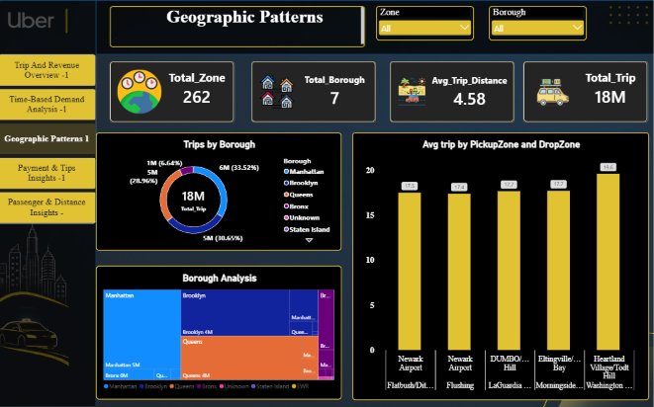
Uber
Dashboard 3: Geographic Patterns
ORIGINAL POWER BI SCREENSHOT
TRIPS
ANALYTICS
FILTERS AND VISUALS AS PROVIDED
🚕
NYC GREEN TAXI
DATA PROJECT

Slide 42
Uber
Dashboard 3: Key Findings
INTERPRETATION • BUSINESS USE
TRIPS
ANALYTICS
KEY METRICS VISIBLE IN THE DASHBOARD
TOTAL ZONES
TOTAL BOROUGHS
AVG TRIP DISTANCE
TOTAL TRIPS
262
7
4.58
18M
WHAT THE DASHBOARD SHOWS
HOW THE BUSINESS CAN USE IT
The borough donut shows Manhattan as the largest share, with Brooklyn and Queens also contributing substantial volume.
Prioritize zone-level monitoring in high-volume boroughs, while checking coverage in lower-volume areas.
The treemap breaks activity down into borough and zone groups for drill-down exploration.
Use the route visual to identify where short-distance and longer-distance patterns differ.
🚕
The pickup-zone/drop-zone chart highlights several route averages, with the highest displayed value around 19.6.
Validate zone/borough labels and route sample sizes before dispatch or pricing decisions; a high average alone does not imply high demand.
NYC GREEN TAXI
DATA PROJECT
Interpretation is based on the values visible in the supplied screenshot; validate measures and filters in the PBIX before operational use.

Slide 43
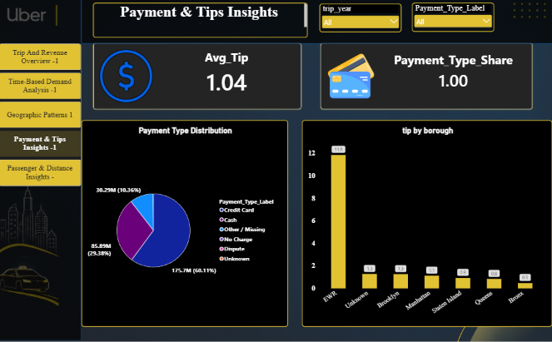
Uber
Dashboard 4: Payment & Tips Insights
ORIGINAL POWER BI SCREENSHOT
TRIPS
ANALYTICS
FILTERS AND VISUALS AS PROVIDED
🚕
NYC GREEN TAXI
DATA PROJECT

Slide 44
Uber
Dashboard 4: Key Findings
INTERPRETATION • BUSINESS USE
TRIPS
ANALYTICS
KEY METRICS VISIBLE IN THE DASHBOARD
AVERAGE TIP
PAYMENT TYPE SHARE
1.04
1.00
WHAT THE DASHBOARD SHOWS
HOW THE BUSINESS CAN USE IT
The payment distribution is led by Credit Card at about 60.11% in the visible chart.
Support card-payment reliability while keeping cash workflows available for riders who use it.
Cash contributes about 29.38%, while Other / Missing is around 10.36%.
Investigate Other / Missing records to improve payment reporting completeness.
🚕
The borough tip chart shows EWR far above the other displayed categories, at approximately 11.8; remaining categories are much lower.
Check EWR sample volume, tip outliers and the borough-versus-location classification before interpreting it as a typical borough pattern.
NYC GREEN TAXI
DATA PROJECT
Interpretation is based on the values visible in the supplied screenshot; validate measures and filters in the PBIX before operational use.

Slide 45
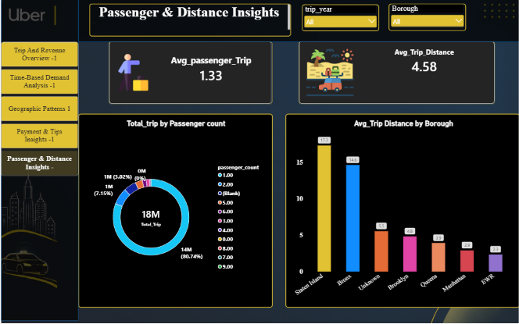
Uber
Dashboard 5: Passenger & Distance Insights
ORIGINAL POWER BI SCREENSHOT
TRIPS
ANALYTICS
FILTERS AND VISUALS AS PROVIDED
🚕
NYC GREEN TAXI
DATA PROJECT

Slide 46
Uber
Dashboard 5: Key Findings
INTERPRETATION • BUSINESS USE
TRIPS
ANALYTICS
KEY METRICS VISIBLE IN THE DASHBOARD
AVG PASSENGERS / TRIP
AVG TRIP DISTANCE
1.33
4.58
WHAT THE DASHBOARD SHOWS
HOW THE BUSINESS CAN USE IT
The passenger-count donut is dominated by one-passenger trips (about 80.74% shown).
Use the high share of single-passenger trips when planning capacity, but do not assume every trip needs a larger vehicle.
The average trip distance differs by borough: Staten Island is highest in the displayed chart, followed by the Bronx.
Review long-distance borough patterns for suitable vehicle positioning and service coverage.
🚕
The dashboard combines passenger-load distribution with a borough comparison of average distance.
Validate blank/zero passenger counts and confirm distance units before using the chart for operational targets.
NYC GREEN TAXI
DATA PROJECT
Interpretation is based on the values visible in the supplied screenshot; validate measures and filters in the PBIX before operational use.

Slide 47
Uber
Problems This Project Helps Identify
FROM ANALYTICS TO ACTION
TRIPS
ANALYTICS
Demand imbalance
Which years, weekdays and hours have higher or falling trip activity?
Revenue volatility
Are revenue changes driven by trip volume, fare levels or data completeness?
Geographic coverage gaps
Which boroughs/zones dominate activity, and where might fleet positioning need review?
Route efficiency
Which pickup–drop-off pairs are common, unusually long, or operationally important?
Payment and tip issues
Which payment types dominate, where are missing categories, and which tip averages need validation?
🚕
Passenger and distance patterns
How often are trips single-passenger, and which boroughs show longer average journeys?
NYC GREEN TAXI
DATA PROJECT
SQL quantifies the questions; Power BI makes patterns and exceptions easier to explore.

Slide 48
Uber
Data Quality & Interpretation Checks
IMPORTANT BEFORE FINAL SUBMISSION
TRIPS
ANALYTICS
The SQL results and dashboard cards show different total-trip figures in places; reconcile date range, table coverage and filters.
The YoY Trips card displays -8E-16, which is a formatting / floating-point artifact and should not be presented as a meaningful percentage.
Some visuals appear to use mismatched measures or labels (for example, repeated total-revenue labels in a time-slot donut).
Confirm currency, distance units, missing values, payment code mappings and passenger-count outliers.
🚕
For route and tip analysis, include minimum trip counts and inspect outliers before making recommendations.
NYC GREEN TAXI
DATA PROJECT
A transparent validation slide strengthens the credibility of the capstone.

Slide 49
Uber
Final Conclusion: SQL + Power BI
CAPSTONE PROJECT • END-TO-END VALUE
TRIPS
ANALYTICS
SQL provides the evidence. Power BI turns it into an operational story.
WHAT SQL CONTRIBUTES
WHAT POWER BI CONTRIBUTES
Combines annual trip tables and calculates trip, revenue and route metrics.
Shows KPIs and trends together across five dashboard pages.
Ranks peak periods, borough shares, frequent routes, passenger loads and tip/payment patterns.
Allows interactive filtering by time, borough, zone and payment category.
Makes business questions measurable and reproducible.
Helps stakeholders explore patterns without rerunning SQL manually.
🚕
Together, SQL and Power BI can help teams investigate demand peaks, revenue shifts, geographic imbalances, route patterns, payment-quality issues and passenger-distance trends. The results support better-informed fleet scheduling and service planning—but recommendations should be confirmed after reconciling totals, validating measures, and checking data quality.
NYC GREEN TAXI
DATA PROJECT
NEXT STEP: validate the underlying model, finalize the report filters, and combine this deck with the SQL edition for submission.

Slide 50
THANK YOU
UBER TRIPS ANALYTICS
SQL analysis + Power BI dashboards
From raw trip data to actionable operational insights
POWER BI EDITION • 5 DASHBOARDS • NYC GREEN TAXI DATA
🚕

